Slide 1
Constraint Satisfaction Problems
Chapter 6

Slide 2
Outline
Constraint Satisfaction Problems (CSP)
Backtracking search for CSPs
Local search for CSPs

Slide 3
Constraint satisfaction problems (CSPs)
Standard search problem:
  state is a "black box“ – any data structure that supports domain-specific information: successor function, heuristic function, and goal test
CSP:
  state is defined by variables X_{i} with values from domain D_{i}
  goal test is a set of constraints specifying allowable combinations of values for subsets of variables
Simple example of a formal representation language
Allows useful general-purpose algorithms instead of problem-specific heuristics

Slide 4

Example: Map-Coloring
Variables WA, NT, Q, NSW, V, SA, T
Domains D_{i} = {red, green, blue}
Constraints: adjacent regions must have different colors
e.g., WA ≠ NT or
(WA,NT) in {(red,green), (red,blue), (green,red), (green,blue), (blue,red), (blue,green)}

Slide 5

Example: Map-Coloring
Solutions are complete and consistent assignments
e.g., {WA = red, NT = green, Q = red, NSW = green, V = red, SA = blue, T = green}

Slide 6

Constraint graph
Binary CSP: each constraint relates two variables
Constraint graph: nodes are variables, arcs are constraints

Slide 7
Varieties of CSPs
Discrete variables
  finite domains:
    n variables, max domain size d → O(d^{n}) complete assignments
    e.g., map coloring, Boolean CSPs
  infinite domains:
    integers, strings, etc.
    e.g., job scheduling, variables are start/end days for each job
    need a constraint language, e.g., StartJob₁ + 5 ≤ StartJob₃
Continuous variables/domains
  e.g., start/end times for Hubble Space Telescope observations
  linear constraints solvable in polynomial time by linear programming

Slide 8
Varieties of constraints
Unary constraints involve a single variable,
  e.g., SA ≠ green
Binary constraints involve pairs of variables,
  e.g., SA ≠ WA
Higher-order constraints involve 3 or more variables,
  e.g., cryptarithmetic column constraints
Preferences (soft constraints) indicate preferred solutions,
  e.g., red is better than green
  Can be represented as costs on variable assignments

Slide 9

Example: Cryptarithmetic
Variables: F T U W R O and X₁ X₂ X₃
Domains: {0,1,2,3,4,5,6,7,8,9} and {0,1}
Constraints: Alldiff (F,T,U,W,R,O)
  O + O = R + 10 · X₁
  X₁ + W + W = U + 10 · X₂
  X₂ + T + T = O + 10 · X₃
  X₃ = F

Slide 10
Real-world CSPs
Assignment problems
  e.g., who teaches what class
Timetable problems
  e.g., which class is offered when and where?
Hardware configuration
Transportation scheduling
Factory scheduling
Spreadsheets
Notice that many real-world problems involve real-valued variables

Slide 11
Standard search formulation (incremental)
Let's start with the straightforward approach, then fix it
Incremental formulation:
Initial state: the empty assignment { }
Successor function: assign a value to an unassigned variable that does not conflict with current assignment
  → fail if no legal assignments
Goal test: the current assignment is complete
Path cost: constant cost for each step
This is the same for all CSPs
Every solution appears at depth n with n variables
→ use depth-first search
b = (n - L) · d at depth L, hence n! · d^{n} leaves
Path is irrelevant, so we can also use complete-state formulation

Slide 12
Backtracking search
Variable assignments are commutative, i.e.,
[ WA = red then NT = green ] same as [ NT = green then WA = red ]
Only need to consider assignments to a single variable at each node
  → only d^{n} leaves
Depth-first search for CSPs with single-variable assignments & backtracking when no legal values remain is called backtracking search
Backtracking search is the basic uninformed algorithm for CSPs
Can solve n-queens for n ≈ 25

Slide 13

Backtracking search

Slide 14

Backtracking example

Slide 15

Backtracking example

Slide 16

Backtracking example

Slide 17

Backtracking example

Slide 18
Improving backtracking efficiency
General-purpose heuristics can give huge gains in speed:
  Which variable should be assigned next?
    (Select-Unassigned-Variable function)
  In what order should its values be tried?
    (Order-Domain-Values function)
  Can we avoid repeating paths that lead to failure?

Slide 19

Most constrained variable
Most constrained variable:
  choose the variable with the fewest legal values
Also called the minimum remaining values (MRV) heuristic

Slide 20

Most constraining variable
Tie-breaker among most constrained variables
Most constraining variable:
  choose the variable with the most constraints on remaining variables
Also called the degree heuristic

Slide 21

Least constraining value
Given a variable, choose the least constraining value:
  the one that rules out the fewest values in the remaining variables
Combining these heuristics makes 1000 queens feasible

Slide 22

Forward checking
Idea:
  Keep track of remaining legal values for unassigned variables
  Backtrack when any variable has no legal values

Slide 23

Forward checking
Idea:
  Keep track of remaining legal values for unassigned variables
  Backtrack when any variable has no legal values

Slide 24

Forward checking
Idea:
  Keep track of remaining legal values for unassigned variables
  Backtrack when any variable has no legal values

Slide 25

Forward checking
Idea:
  Keep track of remaining legal values for unassigned variables
  Backtrack when any variable has no legal values

Slide 26
Constraint propagation
Forward checking propagates information from assigned to unassigned variables, but doesn't provide early detection for all failures:
NT and SA cannot both be blue!
Constraint propagation repeatedly enforces constraints locally

Slide 27

Arc consistency
Simplest form of propagation makes each arc consistent
X →Y is consistent iff
  for every value x of X there is some allowed value y

Slide 28

Arc consistency
Simplest form of propagation makes each arc consistent
X →Y is consistent iff
  for every value x of X there is some allowed y

Slide 29

Arc consistency
Simplest form of propagation makes each arc consistent
X →Y is consistent iff
  for every value x of X there is some allowed y
If X loses a value, neighbors of X need to be rechecked

Slide 30

Arc consistency
Simplest form of propagation makes each arc consistent
X →Y is consistent iff
  for every value x of X there is some allowed y
If X loses a value, neighbors of X need to be rechecked
Arc consistency detects failure earlier than forward checking
Can be run as a preprocessor or after each assignment

Slide 31

Arc consistency algorithm

Slide 32
Local search for CSPs
Hill-climbing, simulated annealing typically use a complete-state formulation, i.e., all variables assigned
To apply to CSPs:
  allow states with unsatisfied constraints
  operators reassign variable values
Variable selection: randomly select any conflicted variable
Value selection by min-conflicts heuristic:
  choose value that violates the fewest constraints
  i.e., hill-climb with h(n) = total number of violated constraints

Slide 33
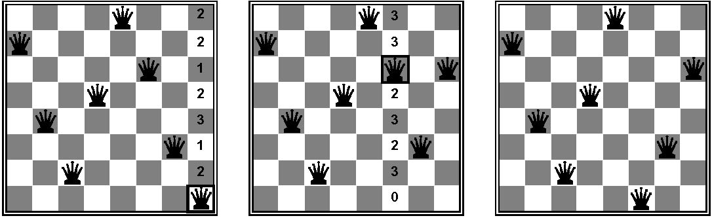
Example: 8-Queens
States: 8 queens in 8 columns (8⁸ states)
Actions: move queen in column
Goal test: no attacking pairs of queens
Evaluation: h(n) = number of attacking pairs

Slide 34
Performance of min-conflicts
Very effective for many CSPs
Given random initial state, can solve n-queens in almost constant time for arbitrary n with high probability (e.g., n = 10,000,000)
  Performance is independent of problem size!
Reduced time required to schedule operations for Hubble Space Telescope from 3 weeks to 10 minutes

Slide 35
Summary
CSPs are a special kind of problem:
  states defined by values of a fixed set of variables
  goal test defined by constraints on variable values
Backtracking: depth-first search with one variable assigned per node
Variable ordering and value selection heuristics significantly improve efficiency
Forward checking prevents assignments that lead to later failure
Constraint propagation (e.g., arc consistency) does additional work to constrain values and detect inconsistencies earlier
Local search using min-conflicts is very effective for solving many CSPs

